Slide 1
VOLATILITY FORECASTING MODELS

Slide 2
Volatility refers to the annualized standard deviation of the change in price or value of a financial security.
OR
Volatility refers to the spread of all likely outcomes of an uncertain variable in this case stock returns.
In finance, we estimate the volatility of an asset using the price of the security, its derivatives, or a combination of these two measures
Volatility forecasting is important because it helps in the following ways:
Risk management: High volatility could lead to losses while low volatility could lead to complacency and hence shocks.
Derivative Pricing and hedging
Market Timing
Portfolio selection
Notes:
Volatility generally refers to fluctuations of something

Slide 3
Characteristics of volatility
Volatility is usually high for certain periods and low for other periods. This gives rise to volatility clusters.
Volatility clustering: refers to periods of high fluctuations often followed by periods of large changes and vice versa.
Volatility evolves over time in a continuous manner, where volatility jumps are rare.
Volatility does not diverge to infinity, as we note that it varies within some fixed range. This may indicate that volatility may be stationary, but it may not be always stationary. Stationarity only exists when the standard deviation of returns remains constant over time.
Volatility seems to react differently to a big price increase and a big price drop with the latter having a greater impact.

Slide 4
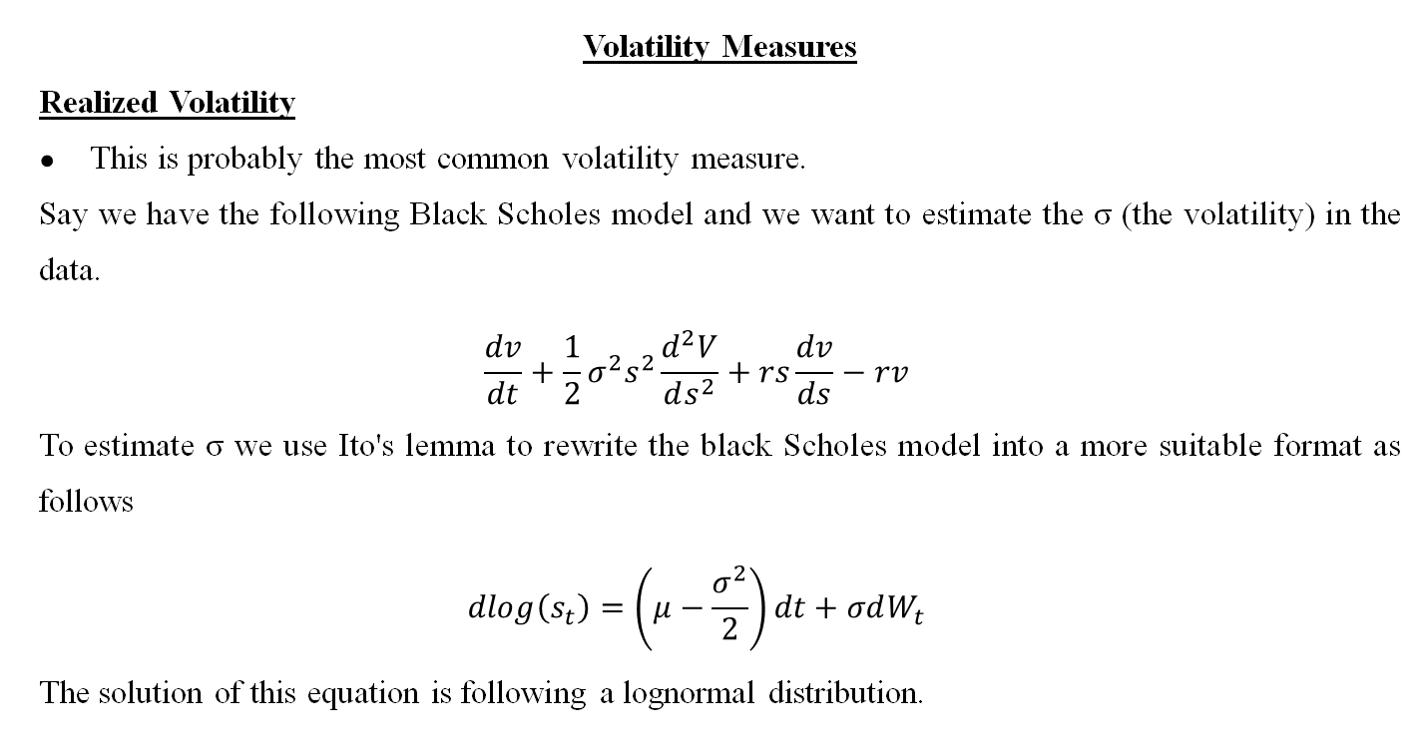
Volatility Measures
Realized Volatility
This is probably the most common volatility measure.
Say we have the following Black Scholes model and we want to estimate the σ (the volatility) in the data.
$$\frac{dv}{dt}+\frac{1}{2}σ^{2}s^{2}\frac{d^{2}V}{ds^{2}}+rs\frac{dv}{ds}−rv$$
To estimate σ we use Ito's lemma to rewrite the black Scholes model into a more suitable format as follows
$$dlog\left(s_{t}\right)=\left(μ−\frac{σ^{2}}{2}\right)dt+σdW_{t}$$
The solution of this equation is following a lognormal distribution.
Notes:
S= stock price
R = risk free rate
σ = volatility
𝑑𝑊_𝑡 = represents the stochastic process, the weiner process

Slide 5
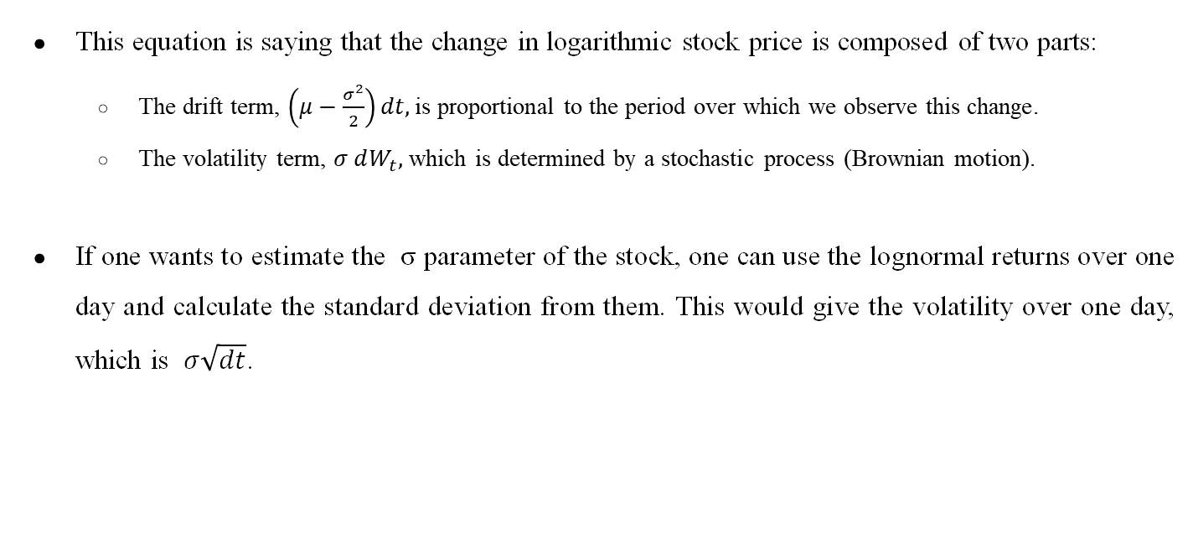
This equation is saying that the change in logarithmic stock price is composed of two parts:
The drift term, $\left(μ−\frac{σ^{2}}{2}\right)dt,$is proportional to the period over which we observe this change.
The volatility term, $σ dW_{t},$ which is determined by a stochastic process (Brownian motion).
If one wants to estimate the σ parameter of the stock, one can use the lognormal returns over one day and calculate the standard deviation from them. This would give the volatility over one day, which is $σ\sqrt{dt}$.
Notes:
The drift term - represents the expected or trend-like component of the change
Volatility term $σ dW_{t}$ represents the random or noisy component of the change.
Last point :::: The standard deviation of lognormal returns effectively quantifies how much the stock price fluctuates over one day.

Slide 6
Advantages of using realized volatility
It measures the actual asset performance in the past. It helps to understand the stability of the asset based on its past performance.
It indicates how an asset’s price changed in the past and the period in which it has changed.
Higher the volatility, the higher the price risk associated with the stock. Therefore, a higher premium is attached to the stock.
One may use the realized volatility of the asset to forecast future volatility, i.e., implied volatility of the asset.
Realized volatility is measured based on statistical methods and is, therefore, a reliable indicator of the volatility in asset value.
Disadvantages
It is a measure of historical volatility and is therefore not forward-looking. It does not factor in any major “shocks” in the market that may arise in the future, affecting the underlying value.
It assumes that asset prices reflect all available information while measuring volatility.

Slide 7
Implied Volatility
Implied volatility (IV) is a metric used to forecast what the market thinks about the future price movements of an option’s underlying stock.
IV offers traders a general range of prices that a security is anticipated to swing between and helps indicate good entry and exit points.
IV is affected by a number of factors, with the most significant being supply and demand and time value.
It is calculated using the Black-Scholes model where we can calculate the call or put option price

Slide 8

European call option
$$C=S_{0}e^{−qt}N\left(d_{1}\right)−X_{e^{−rt}}N(d_{2})$$
Where:
C = Option price
$S_{0}$ = Current stock price
X = strike price
t = time to expiration
r = risk-free interest rate
q = is the dividend yield.
N(.) = Cumulative distribution function of the standard normal distribution
$d_{1} and d_{2}$are variables in the formula that involves implied volatility.
Notes:
S₀ = Current Stock Price:
This is the current market price of the underlying stock.
X = Strike Price:
The strike price is the predetermined price at which the option holder has the right to buy the underlying stock.

Slide 9
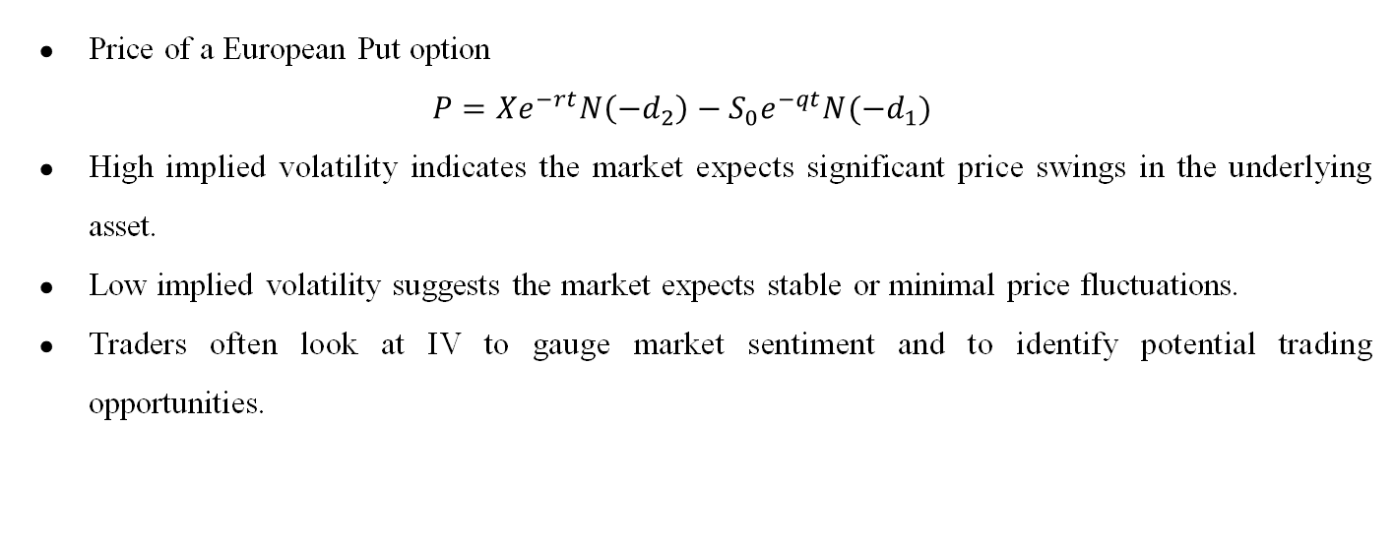
Price of a European Put option
$$P=Xe^{−rt}N\left(−d_{2}\right)−S_{0}e^{−qt}N({−d}_{1})$$
High implied volatility indicates the market expects significant price swings in the underlying asset.
Low implied volatility suggests the market expects stable or minimal price fluctuations.
Traders often look at IV to gauge market sentiment and to identify potential trading opportunities.

Slide 10

Volatility Models
To put the volatility models in proper perspective, it is useful to consider the conditional mean and variance of $y_{t}$given the information set $I_{t−1}$
Where :
yt is the observed value of a variable.
$I_{t−1 }$is consists of all linear functions of the past observed values of this variable
$$μ_{t}=E[y_{t}|I_{t−1}]$$
$$σ_{t}^{2}=var\left[y_{t} | I_{t−1}\right]=E[\left(y_{t}−μ_{t}\right)2 |I_{t−1}]$$
$μ_{t}$ is the expected mean

Slide 11
Volatility Models
ARCH
GARCH
EGARCH
TGARCH
EGARCH and TGARCH models were developed to capture the asymmetric effects in volatility that is induced by the differences in positive and negative price movements.

Slide 12
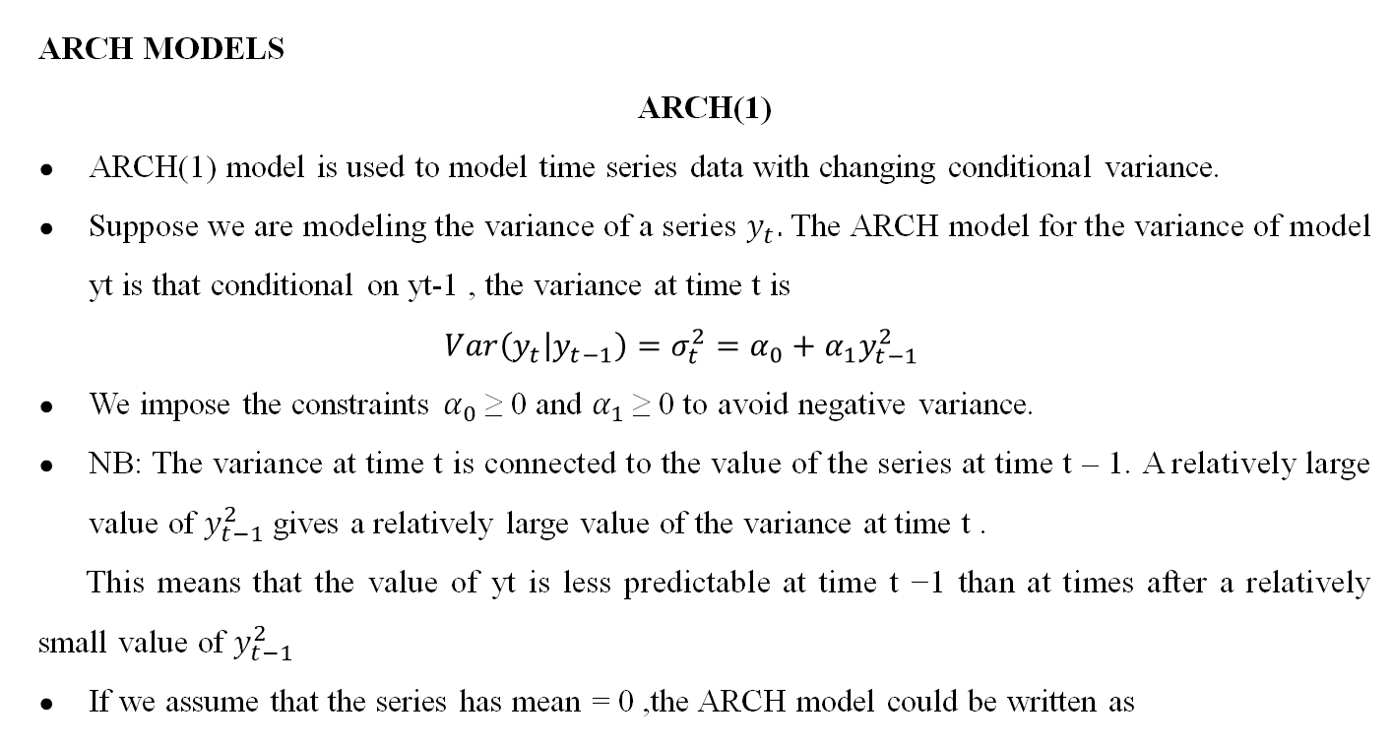
ARCH MODELS
ARCH(1)
ARCH(1) model is used to model time series data with changing conditional variance.
Suppose we are modeling the variance of a series $y_{t}.$The ARCH model for the variance of model yt is that conditional on yt-1 , the variance at time t is
$$Var\left(y_{t} | y_{t−1}\right)=σ_{t}^{2}=α_{0}+α_{1}y_{t−1}^{2}$$
We impose the constraints $α_{0}$≥ 0 and $α_{1}$≥ 0 to avoid negative variance.
NB: The variance at time t is connected to the value of the series at time t – 1. A relatively large value of $y_{t−1}^{2}$ gives a relatively large value of the variance at time t .
This means that the value of yt is less predictable at time t −1 than at times after a relatively small value of $y_{t−1}^{2}$
If we assume that the series has mean = 0 ,the ARCH model could be written as
Notes:
(AFTER FIRST POINT) These models are particularly useful in financial time series analysis to capture changing volatility over time.

Slide 13
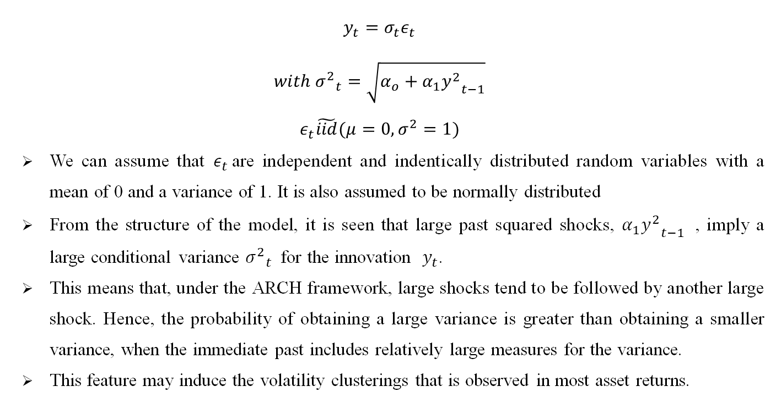
$$y_{t}=σ_{t}ε_{t}$$
$$with {σ^{2}}_{t}=\sqrt{α_{o}+α_{1}{y^{2}}_{t−1}}$$
$$ε_{t}\tilde{iid}(μ=0,σ^{2}=1)$$
We can assume that $ε_{t }$are independent and indentically distributed random variables with a mean of 0 and a variance of 1. It is also assumed to be normally distributed
From the structure of the model, it is seen that large past squared shocks, $α_{1}{y^{2}}_{t−1}$ , imply a large conditional variance ${σ^{2}}_{t}$ for the innovation $y_{t}$.
This means that, under the ARCH framework, large shocks tend to be followed by another large shock. Hence, the probability of obtaining a large variance is greater than obtaining a smaller variance, when the immediate past includes relatively large measures for the variance.
This feature may induce the volatility clusterings that is observed in most asset returns.
Notes:
Yt = current value of the time series
Sigma t is the condition standard deviation
Et is the white noise error term.

Slide 14
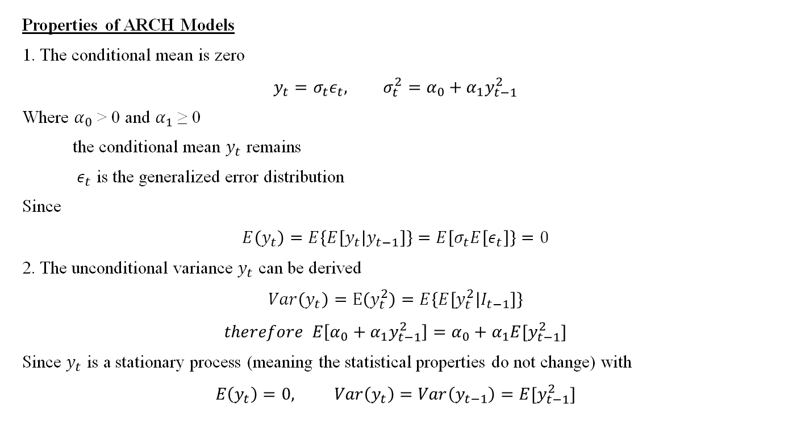
Properties of ARCH Models
1. The conditional mean is zero
$$y_{t}=σ_{t}ε_{t}, σ_{t}^{2}=α_{0}+α_{1}y_{t−1}^{2}$$
Where $α_{0}$ > 0 and $α_{1}$ ≥ 0
the conditional mean $y_{t}$ remains
$ε_{t}$ is the generalized error distribution
Since
$$E\left(y_{t}\right)=E\left\{E\left[y_{t} | y_{t−1}\right]\right\}=E\left[σ_{t}E\left[ε_{t}\right]\right\}=0$$
2. The unconditional variance $y_{t}$ can be derived
$$Var\left(y_{t}\right)=E\left(y_{t}^{2}\right)=E\left\{E\left[y_{t}^{2} | I_{t−1}\right]\right\}$$
$$therefore E\left[α_{0}+α_{1}y_{t−1}^{2}\right]=α_{0}+α_{1}{E[y}_{t−1}^{2}]$$
Since $y_{t}$ is a stationary process (meaning the statistical properties do not change) with
$$E\left(y_{t}\right)=0, Var\left(y_{t}\right)=Var\left(y_{t−1}\right)={E[y}_{t−1}^{2}]$$
Notes:
The conditional mean is zero since on average the series does not have a constant mean.
Next slide : In some applications, especially those involving risk assessment or the analysis of extreme events, it may be necessary to consider higher-order moments of the variable yt which represents the return or volatility.

Slide 15

Therefore, we have
$$Var\left(y_{t}\right)=α_{0}+α_{1}Var\left(y_{t}\right)$$
And $Var\left(y_{t}\right)= \frac{α_{o}}{(1−α_{1})}$
Since $y_{t}$ must be positive, we impose restrictions on $α_{1}$ to ensure this such that 0≤ $α_{1}$<1
3. In some applications we may use higher order moments of $y_{t}$. Therefore $α_{1}$ must also satisfy some conditional constraints.
$$E\left(y_{t}^{4}\right)=E\left\{E\left[y4t | I_{t−1}\right]\right\}=3E(α_{0}+α_{1}y_{t−1}^{2})^2$$
$$=3E(α_{o}^{2}+2α_{0}α_{1}y_{t−1}^{2}+α_{1}^{2}y4_{t−1})$$
Notes:
At this point $Var\left(y_{t}\right)= \frac{α_{o}}{(1−α_{1})}$ , variance reached a steady state value that does not change
Point 3: For example to study the tail of distribution of volatility, we require that the fourth moment of $y_{t}$ is finite under the normality assumption of the error term.

Slide 16
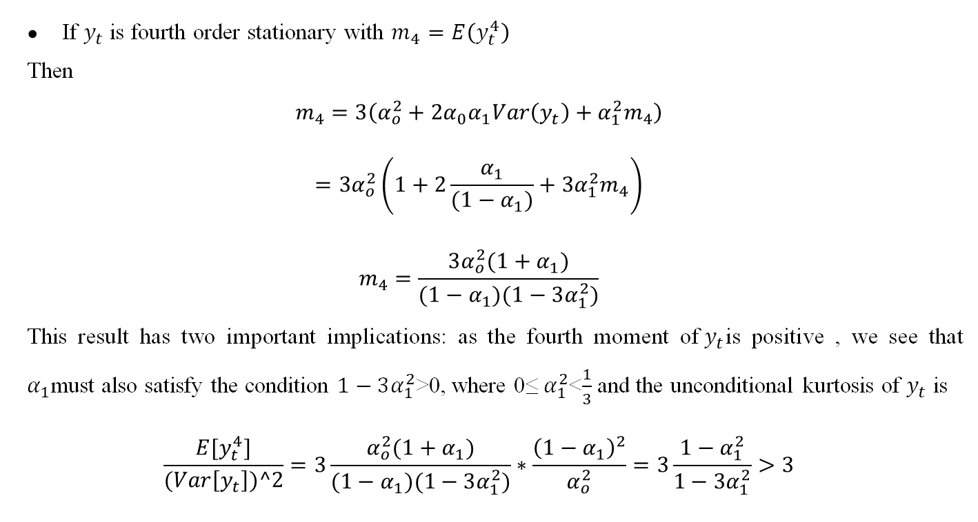
If $y_{t}$ is fourth order stationary with $m_{4}=E\left(y_{t}^{4}\right)$
Then
$$m_{4}=3\left(α_{o}^{2}+2α_{0}α_{1}Var\left(y_{t}\right)+α_{1}^{2}m_{4}\right)$$
$$=3α_{o}^{2}\left(1+2\frac{α_{1}}{(1−α_{1})}+3α_{1}^{2}m_{4}\right)$$
$$m_{4}=\frac{3α_{o}^{2}(1+α_{1})}{(1−α_{1})(1−3α_{1}^{2})}$$
This result has two important implications: as the fourth moment of${ y}_{t}$is positive , we see that $α_{1}$must also satisfy the condition $1−3α_{1}^{2}$>0, where 0≤ $α_{1}^{2}$<$\frac{1}{3}$ and the unconditional kurtosis of $y_{t}$ is
$$\frac{E[y_{t}^{4}]}{(Var\left[y_{t}\right])^2}=3\frac{α_{o}^{2}(1+α_{1})}{(1−α_{1})(1−3α_{1}^{2})}∗\frac{{\left(1−α_{1}\right)}^{2}}{α_{o}^{2}}=3\frac{1−α_{1}^{2}}{1−3α_{1}^{2}}>3$$

Slide 17
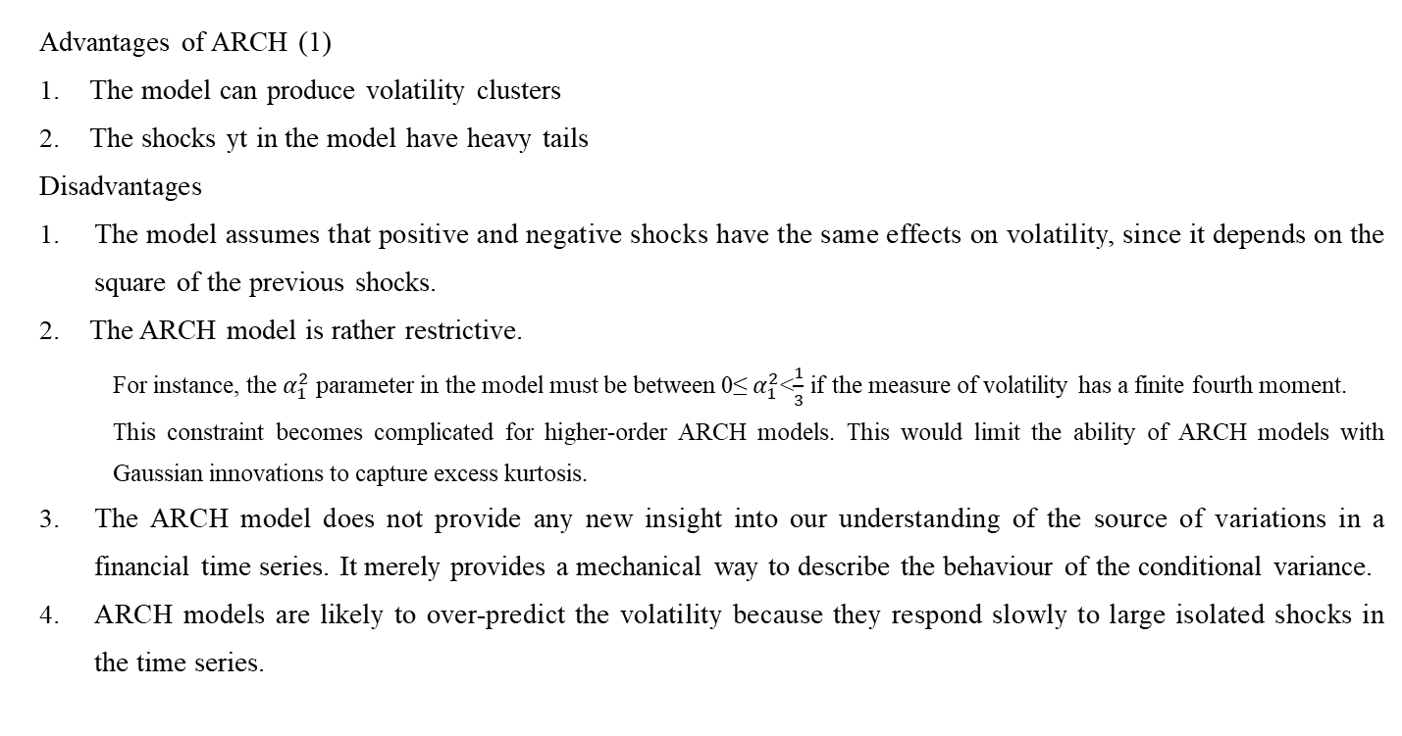
Advantages of ARCH (1)
The model can produce volatility clusters
The shocks yt in the model have heavy tails
Disadvantages
The model assumes that positive and negative shocks have the same effects on volatility, since it depends on the square of the previous shocks.
The ARCH model is rather restrictive.
For instance, the $α_{1}^{2}$parameter in the model must be between 0≤ $α_{1}^{2}$<$\frac{1}{3}$ if the measure of volatility has a finite fourth moment.
This constraint becomes complicated for higher-order ARCH models. This would limit the ability of ARCH models with Gaussian innovations to capture excess kurtosis.
The ARCH model does not provide any new insight into our understanding of the source of variations in a financial time series. It merely provides a mechanical way to describe the behaviour of the conditional variance.
ARCH models are likely to over-predict the volatility because they respond slowly to large isolated shocks in the time series.
Notes:
The ARCH(1) model is the simplest form in the ARCH family and focuses on modeling volatility based on only the previous period's squared error term (squared residual).
Use Case: ARCH(1) is suitable for capturing volatility clustering, where periods of high volatility tend to be followed by more periods of high volatility.
Advantage 2: ARCH(1) is suitable for modeling heavy-tailed shocks because it allows the conditional variance to respond to extreme past residuals. When the model detects heavy-tailed shocks in the data, it can increase the conditional variance for future periods, which is crucial for risk management and capturing rare but impactful events in financial markets.

Slide 18


Slide 19
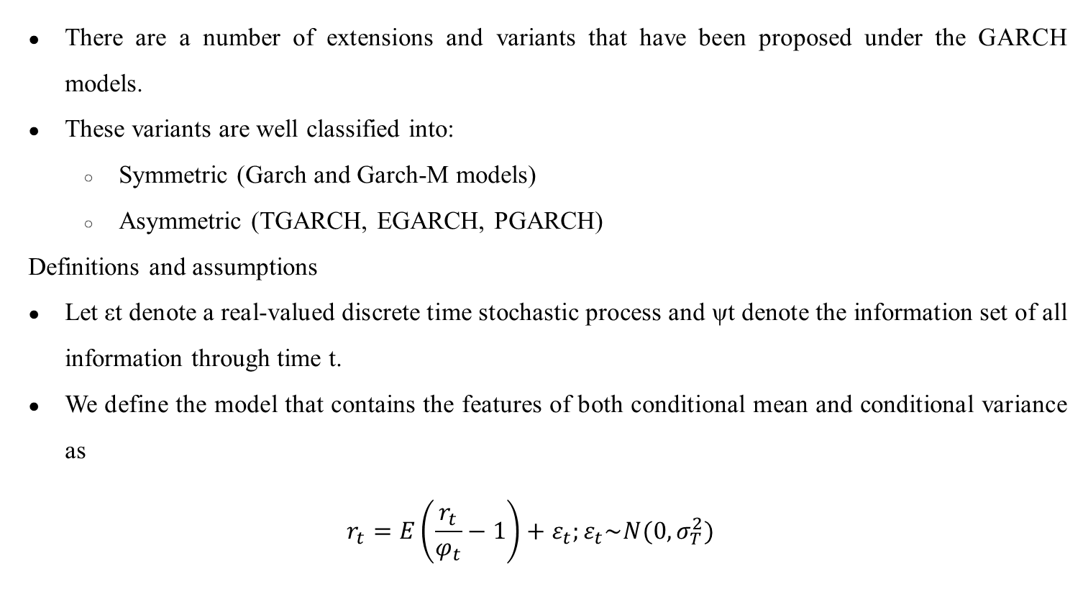
There are a number of extensions and variants that have been proposed under the GARCH models.
These variants are well classified into:
Symmetric (Garch and Garch-M models)
Asymmetric (TGARCH, EGARCH, PGARCH)
Definitions and assumptions
Let εt denote a real-valued discrete time stochastic process and ψt denote the information set of all information through time t.
We define the model that contains the features of both conditional mean and conditional variance as
$$r_{t}=E\left(\frac{r_{t}}{φ_{t}}−1\right)+ε_{t};ε_{t}\sim N(0,σ_{T}^{2})$$

Slide 20

The above equation can be written as
rt=μt+εt. (The equation we will use to describe the conditional mean)
In the above equation, μt=E(rt/ψt−1) this expression is used to model the conditional mean of rt given the information through time t − 1.
The error is assumed to be non constant quantity with respect to time and thus given by $ε_{t}=σ_{t}α_{t}$
$$where σ_{t}=\sqrt{V(\frac{r_{t}}{φ_{t−1}})}and α_{t}\sim N(0,1)$$

Slide 21
Symmetric GARCH models
In the symmetric GARCH models, the conditional variance only depends on the magnitude of the underlying asset and not on the sign.
This ignores the effect raised by the positive or negative asset on conditional variance.
The widely used symmetric GARCH models include the generalized autoregressive conditional heteroscedasticity (GARCH) model and GARCH in the mean model.

Slide 22
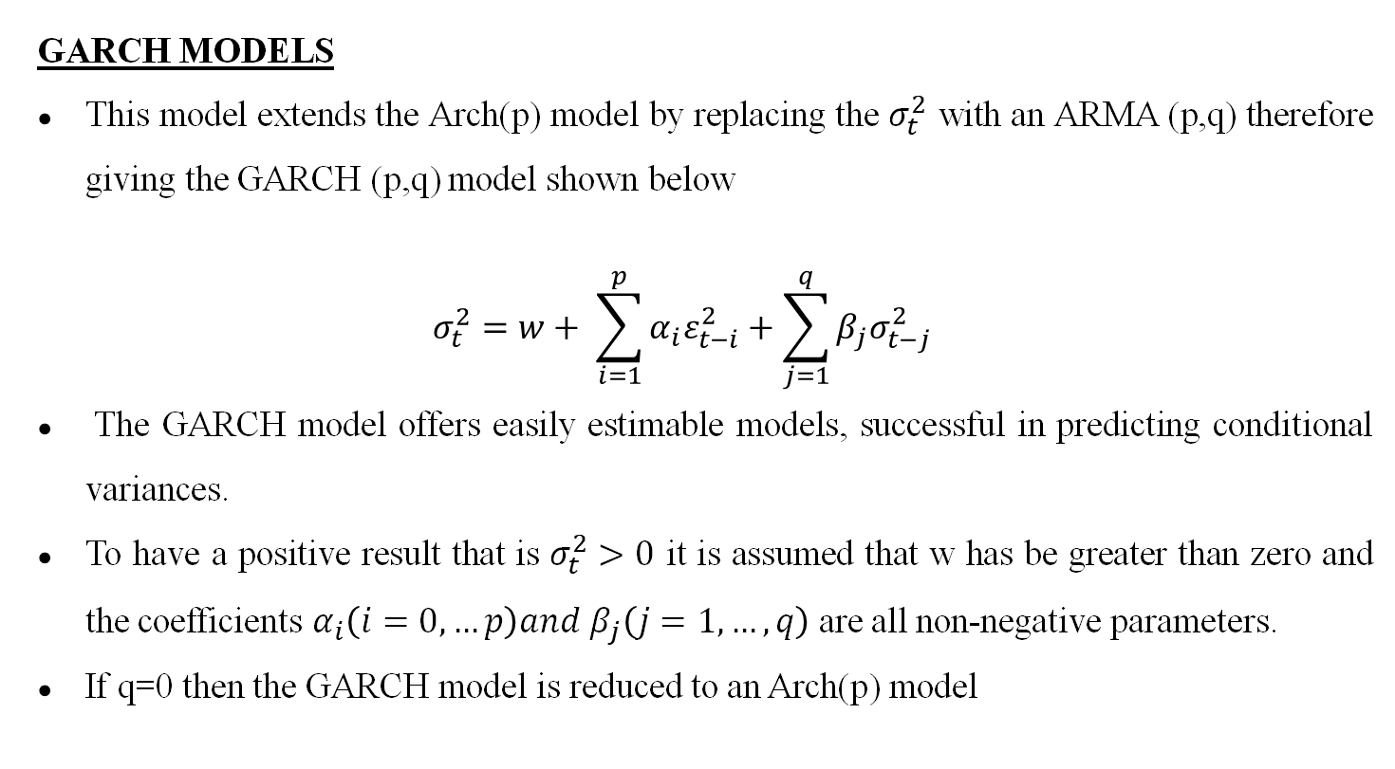
GARCH MODELS
This model extends the Arch(p) model by replacing the $σ_{t}^{2}$ with an ARMA (p,q) therefore giving the GARCH (p,q) model shown below
$$σ_{t}^{2}=w+ \sum_{i=1}^{p}{α_{i}ε_{t−i}^{2}+\sum_{j=1}^{q}{β_{j}σ_{t−j}^{2}}}$$
The GARCH model offers easily estimable models, successful in predicting conditional variances.
To have a positive result that is $σ_{t}^{2}>0$ it is assumed that w has be greater than zero and the coefficients $α_{i}\left(i=0, …p\right)and β_{j}\left(j=1,…,q\right)$are all non-negative parameters.
If q=0 then the GARCH model is reduced to an Arch(p) model
Notes:
{Rt}(return at time t) is a covariance stationary and ergodic process provided α1+β1<1 – the stability of the terms α1+β1<1 ensures that the conditional variance sigma squared remains bounded by time
Suggests the relationship between the variance of the returns, the expectation of the squared innovation and the expectation of the conditional variance

Slide 23
Widely used GARCH specification suggests the best predictor of next period's variance is a weighted average of: Long-run average variance, Predicted variance for the current period, and Latest information represented by the squared residual from the most recent period.
This updating mechanism reflects adaptive or learning behavior which can be likened to Bayesian updating.
Illustration
Look at a trader who knows the long-run average daily standard deviation of the S&P500 is 1%, that the forecast he made yesterday was 2% and the unexpected return observed today is 3%.
This is a high volatility period and today is especially volatile suggesting that the forecast for tomorrow could be even higher (volatility clustering).

Slide 24
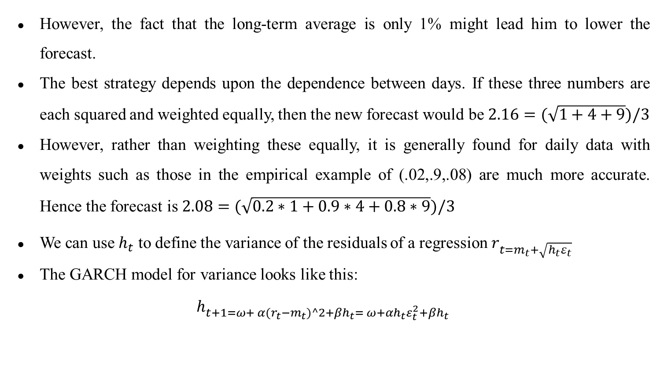
However, the fact that the long-term average is only 1% might lead him to lower the forecast.
The best strategy depends upon the dependence between days. If these three numbers are each squared and weighted equally, then the new forecast would be $2.16=(\sqrt{1+4+9})/3$
However, rather than weighting these equally, it is generally found for daily data with weights such as those in the empirical example of (.02,.9,.08) are much more accurate. Hence the forecast is $2.08=(\sqrt{0.2∗1+0.9∗4+0.8∗9})/3$
We can use $h_{t}$ to define the variance of the residuals of a regression $r_{t=m_{t}+\sqrt{h_{t}ε_{t}}}$
The GARCH model for variance looks like this:
$$h_{t+1={ω+ α(r_{t}−m}_{t})^2+βh_{t}= ω+αh_{t}ε_{t}^{2}+βh_{t}}$$

Slide 25
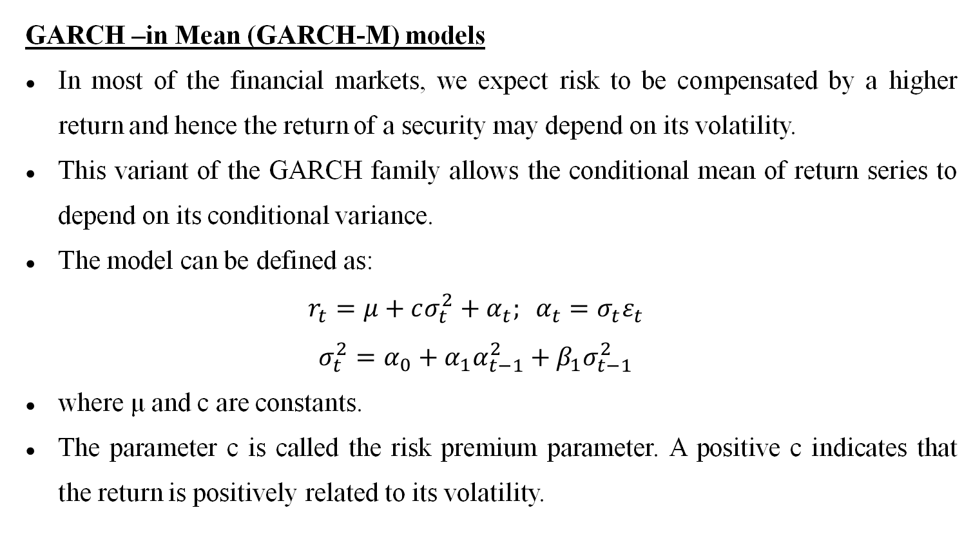
GARCH –in Mean (GARCH-M) models
In most of the financial markets, we expect risk to be compensated by a higher return and hence the return of a security may depend on its volatility.
This variant of the GARCH family allows the conditional mean of return series to depend on its conditional variance.
The model can be defined as:
$$r_{t}=μ+cσ_{t}^{2}+α_{t}; α_{t}=σ_{t}ε_{t}$$
$$σ_{t}^{2}=α_{0}+α_{1}α_{t−1}^{2}+β_{1}σ_{t−1}^{2}$$
where μ and c are constants.
The parameter c is called the risk premium parameter. A positive c indicates that the return is positively related to its volatility.

Slide 26
Asymmetric GARCH models
These models are motivated by the need to distinguish between good news and bad news and their impact on volatility in financial markets.
Engle, introduced the news impact curve and summarized the effect of a shock interpreted as a negative shock (bad news) or a positive shock (good news) on the time-varying conditional variance.
For many stock returns, there is a negative correlation between the current return and the future volatility.
The tendency of volatility to decline when the return rises and to rise when the return falls is called the leverage effect.
Symmetric models fail to explain the leverage effect due to the incapability of conditional variance to respond asymmetrically.

Slide 27
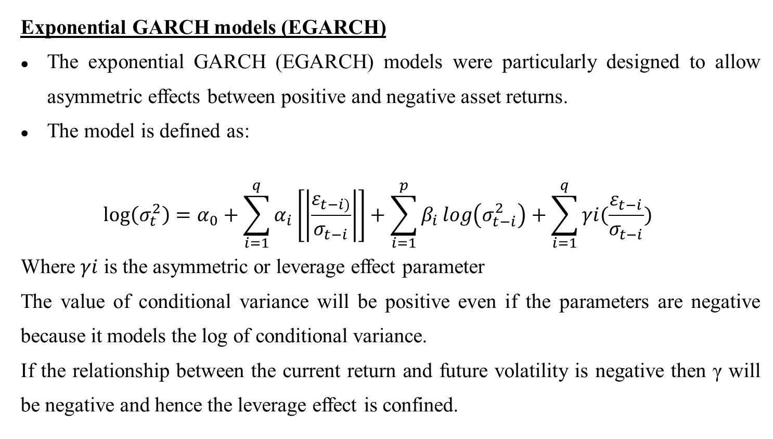
Exponential GARCH models (EGARCH)
The exponential GARCH (EGARCH) models were particularly designed to allow asymmetric effects between positive and negative asset returns.
The model is defined as:
$$\log\left(σ_{t}^{2}\right)=α_{0}+\sum_{i=1}^{q}{α_{i}\left[\left|\frac{ε_{t−i)}}{σ_{t−i}}\right|\right]+\sum_{i=1}^{p}{β_{i}}}log\left(σ_{t−i}^{2}\right)+\sum_{i=1}^{q}{γi(\frac{ε_{t−i}}{σ_{t−i}})}$$
Where $γi$ is the asymmetric or leverage effect parameter
The value of conditional variance will be positive even if the parameters are negative because it models the log of conditional variance.
If the relationship between the current return and future volatility is negative then γ will be negative and hence the leverage effect is confined.

Slide 28
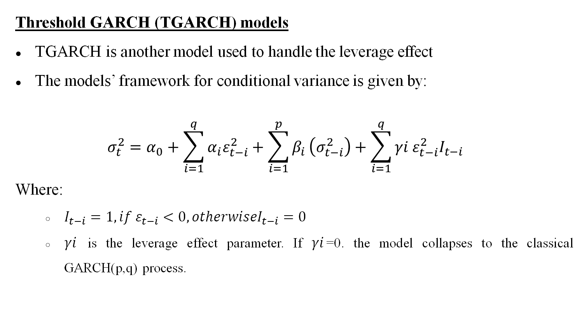
Threshold GARCH (TGARCH) models
TGARCH is another model used to handle the leverage effect
The models’ framework for conditional variance is given by:
$$σ_{t}^{2}=α_{0}+\sum_{i=1}^{q}{α_{i}ε_{t−i}^{2}+\sum_{i=1}^{p}{β_{i}}}\left(σ_{t−i}^{2}\right)+\sum_{i=1}^{q}{γi ε_{t−i}^{2}I_{t−i}}$$
Where:
$I_{t−i}=1, if ε_{t−i}<0, otherwiseI_{t−i}=0$
$γi$ is the leverage effect parameter. If $γi$=0. the model collapses to the classical GARCH(p,q) process.

Slide 29
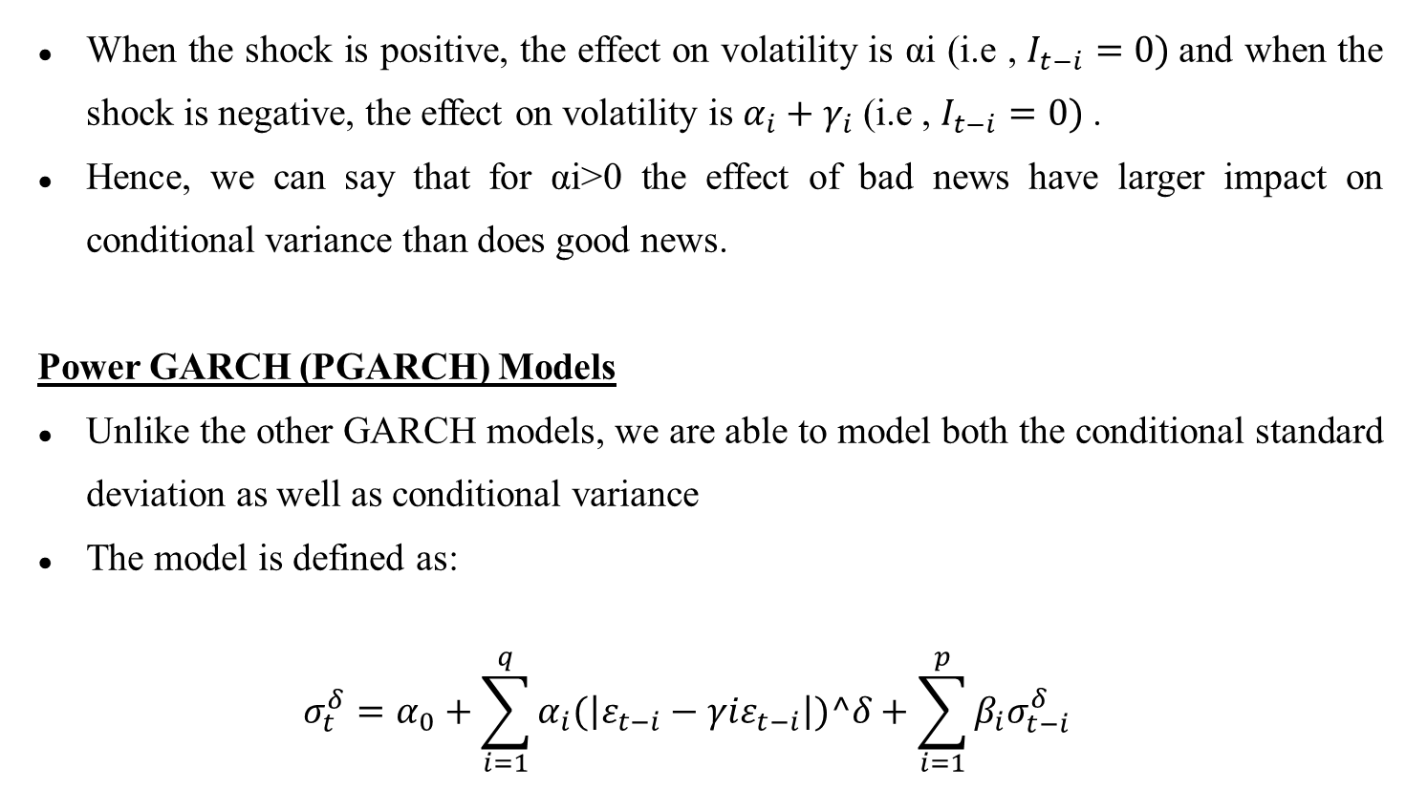
When the shock is positive, the effect on volatility is αi (i.e , $I_{t−i}=0)$and when the shock is negative, the effect on volatility is $α_{i}+γ_{i}$ (i.e , $I_{t−i}=0)$.
Hence, we can say that for αi>0 the effect of bad news have larger impact on conditional variance than does good news.
Power GARCH (PGARCH) Models
Unlike the other GARCH models, we are able to model both the conditional standard deviation as well as conditional variance
The model is defined as:
$$σ_{t}^{δ}=α_{0}+\sum_{i=1}^{q}{α_{i}(\left|ε_{t−i}−γiε_{t−i}\right|)^δ}+\sum_{i=1}^{p}{β_{i}σ_{t−i}^{δ}}$$

Slide 30
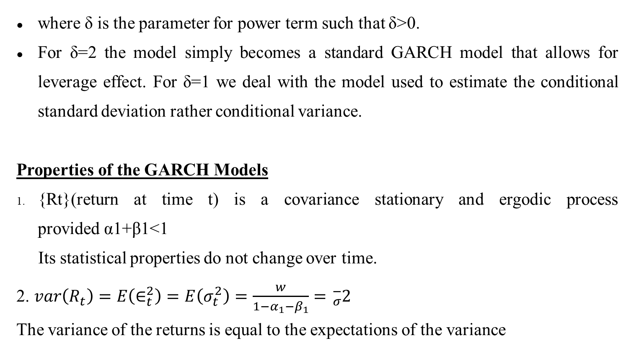
where δ is the parameter for power term such that δ>0.
For δ=2 the model simply becomes a standard GARCH model that allows for leverage effect. For δ=1 we deal with the model used to estimate the conditional standard deviation rather conditional variance.
Properties of the GARCH Models
{Rt}(return at time t) is a covariance stationary and ergodic process provided α1+β1<1
Its statistical properties do not change over time.
2. $var\left(R_{t}\right)=E\left(∈_{t}^{2}\right)=E\left(σ_{t}^{2}\right)=\frac{w}{1−α_{1}−β_{1}}={}_{σ}^{−}2$
The variance of the returns is equal to the expectations of the variance

Slide 31
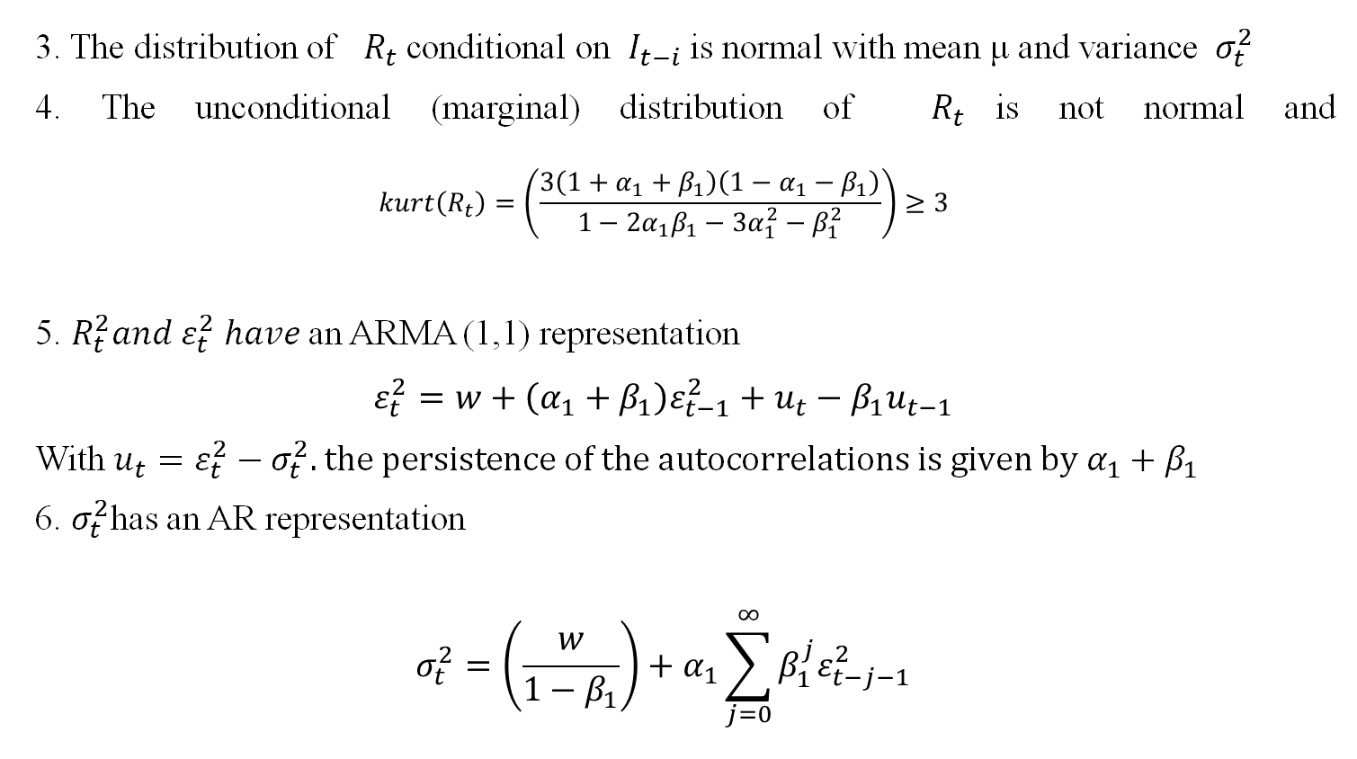
3. The distribution of $R_{t}$conditional on $I_{t−i}$is normal with mean μ and variance $σ_{t}^{2}$
4. The unconditional (marginal) distribution of $R_{t}$is not normal and $$kurt\left(R_{t}\right)=\left(\frac{3\left(1+α_{1}+β_{1}\right)\left(1−α_{1}−β_{1}\right)}{1−2α_{1}β_{1}−3α_{1}^{2}−β_{1}^{2}}\right)≥3$$
5. $R_{t}^{2}and ε_{t}^{2} have$an ARMA (1,1) representation
$$ε_{t}^{2}=w+\left(α_{1}+β_{1}\right)ε_{t−1}^{2}+u_{t}−β_{1}u_{t−1}$$
With $u_{t}=ε_{t}^{2}−σ_{t}^{2}. the persistence of the autocorrelations is given by{ α}_{1}+β_{1}$
6. $σ_{t}^{2}$has an AR representation
$$σ_{t}^{2}=\left(\frac{w}{1−β_{1}}\right)+α_{1}\sum_{j=0}^{∞}{β_{1}^{j}ε_{t−j−1}^{2}}$$

Slide 32
Summary
Financial time series have the property of thick tails which are thicker than those of the normal distribution.
The problem encountered by the GARCH models is that they do not fully embrace this property of thick/heavy tails which are so much evident in the behavior of financial time series.
Therefore to address this short comings, different approaches have been employed to improve results including the students t-distribution and non normal distribution.
To model skewness and kurtosis, asymmetric stable density and t-distribution model have been used largely.

Slide 33
Support Vector Regression: GARCH
SVM for classification is known as support vector classification (SVC).
Keeping all characteristics of SVM, it can be applicable to regression. Again, in regression, the aim is to find the hyperplane that minimizes the error and maximizes the margin. This method is called support vector regression (SVR) and, in this part, we will apply this method to the GARCH model. Combining these two models gets us SVR-GARCH.
SVR-GARCH (Linear) - In SVR, a linear kernel means that the model assumes a linear relationship between the input variables and the output predictions.
It's the simplest form of kernel, used when the data is believed to be linearly separable. This combined approach can be particularly useful in financial markets where forecasting both the value and the associated risk (volatility) is important for making informed decisions.

Slide 34
SVR-GARCH (RBF) - model could be employed to predict financial time series data, where SVR with the RBF kernel is used to predict values (like returns or prices) while taking into account the changing volatility captured by the GARCH model.
This type of model can be particularly powerful in financial applications where both the magnitude and uncertainty (volatility) of future values are of interest.

Slide 35
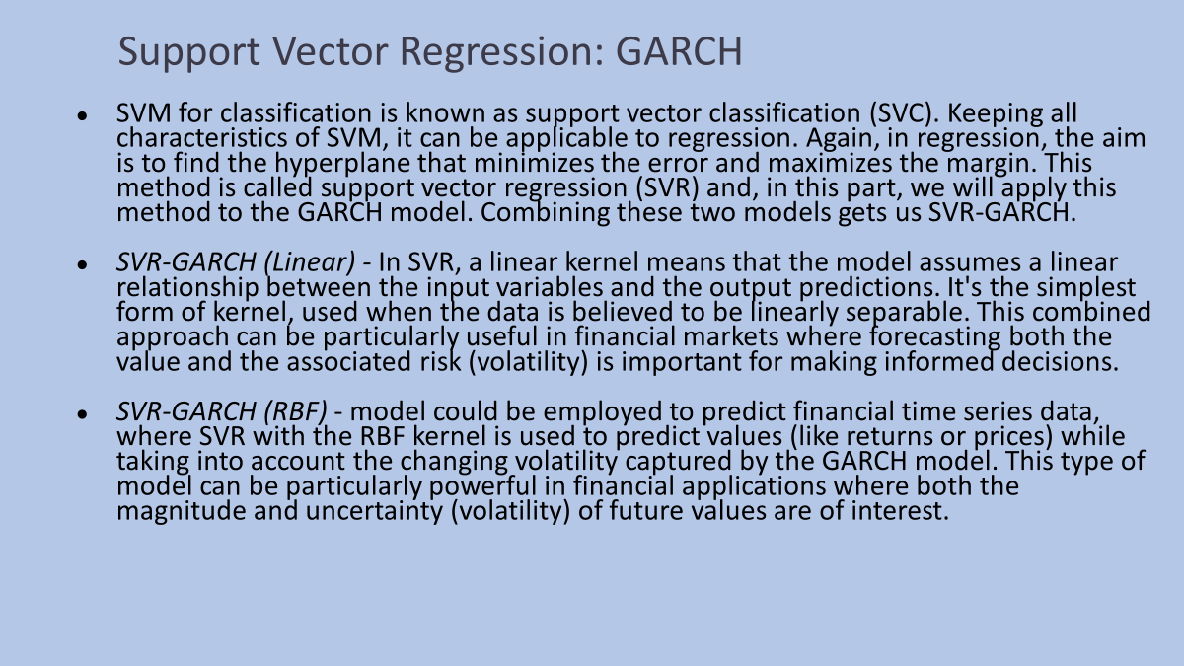

Slide 36
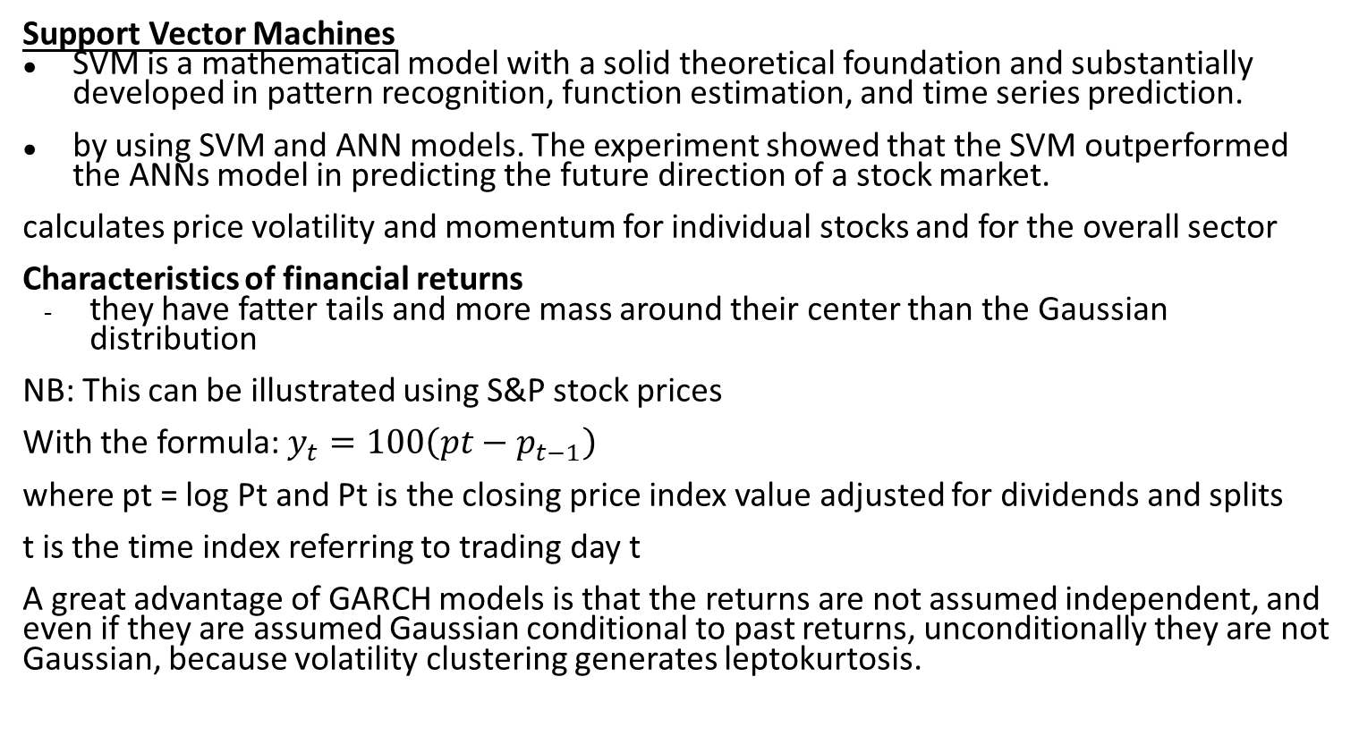
Support Vector Machines
SVM is a mathematical model with a solid theoretical foundation and substantially developed in pattern recognition, function estimation, and time series prediction.
by using SVM and ANN models. The experiment showed that the SVM outperformed the ANNs model in predicting the future direction of a stock market.
calculates price volatility and momentum for individual stocks and for the overall sector
Characteristics of financial returns
they have fatter tails and more mass around their center than the Gaussian distribution
NB: This can be illustrated using S&P stock prices
With the formula: $y_{t}=100\left(pt−p_{t−1}\right)$
where pt = log Pt and Pt is the closing price index value adjusted for dividends and splits
t is the time index referring to trading day t
A great advantage of GARCH models is that the returns are not assumed independent, and even if they are assumed Gaussian conditional to past returns, unconditionally they are not Gaussian, because volatility clustering generates leptokurtosis.

Slide 37
Support Vector Regression: GARCH
SVM for classification is known as support vector classification (SVC). Keeping all characteristics of SVM, it can be applicable to regression. Again, in regression, the aim is to find the hyperplane that minimizes the error and maximizes the margin. This method is called support vector regression (SVR) and, in this part, we will apply this method to the GARCH model. Combining these two models gets us SVR-GARCH.
SVR-GARCH (Linear) - In SVR, a linear kernel means that the model assumes a linear relationship between the input variables and the output predictions. It's the simplest form of kernel, used when the data is believed to be linearly separable. This combined approach can be particularly useful in financial markets where forecasting both the value and the associated risk (volatility) is important for making informed decisions.
SVR-GARCH (RBF) - model could be employed to predict financial time series data, where SVR with the RBF kernel is used to predict values (like returns or prices) while taking into account the changing volatility captured by the GARCH model. This type of model can be particularly powerful in financial applications where both the magnitude and uncertainty (volatility) of future values are of interest.

Slide 38
THE END

Slide 39
Before the market crash in 1987, the Black-Scholes (B-S) model which was built on geometric Brownian motion (GBM) with constant volatility and drift was the dominant model.
Estimation/Prediction Approaches
Historical/sample volatility measures.
Geometric Brownian Motion Model
Poisson Jump Diffusion Model
ARCH/GARCH Models
Stochastic Volatility (SV) Models
Implied volatility from options/derivatives

Slide 41
Todays search materials https://volquant.medium.com/a-brief-history-of-volatility-models-cc0bbefe8b90
VOLATILITY NOTES https://www.linkedin.com/pulse/introduction-volatility-modeling-quantace-research/
https://mc-stan.org/docs/2_21/stan-users-guide/stochastic-volatility-models.html

Slide 42
FUTURE TOPICS LEADING FROM THIS 1. Random Forest Based Feature Selection of Macroeconomic Variables for Stock Market Prediction https://www.zbw.eu/econis-archiv/bitstream/11159/411278/1/EBP076225380_0.pdf
2. Modeling stock market return volatility in the presence of structural breaks: Evidence from Nairobi Securities Exchange, Kenya
https://academic.oup.com/jfec/advance-article/doi/10.1093/jjfinec/nbad005/7081291 machine learning

